Slide 1
Team Dynamics and Leadership
Dr. Michelle Clemons

Slide 2
https://spark.adobe.com/video/SA7D1cSPYhViG
https://spark.adobe.com/video/tZ64xlRBE9BEF

Slide 3
Agenda
Six Leadership Styles
What Makes a Leader
Levels of Leadership
Six Steps of Effective Leadership

Slide 4
Six Leadership Styles
Commanding “Do as I say.”
Visionary “Come with me.”
Affiliate “People come first.”
Democratic “What do you think?”
Pacesetting “Do at my pace.”
Coaching “Try this.”
Goleman, David. "Leadership that Gets Results" Harvard Business Review. March-April 2000 p. 82-83.

Slide 5
Six Leadership Styles
Count off by 12
Move to new groups
Goleman, David. "Leadership that Gets Results" Harvard Business Review. March-April 2000 p. 82-83.

Slide 6
Six Leadership Styles
Three leaders for your style.
Their names, what they do/did, why you picked them.
Three pros and three cons of that leadership style.
Additionally, pick one piece of media (song, TV show, movie, etc.) where that leadership style is demonstrated.

Slide 7
What Makes a Leader?
Self-Awareness
Self-Regulation
Motivation
Empathy
Social Skill
Why are these soft skills so essential?
How can you improve in these areas?

Slide 8
Are You Empathetic?
Please answer each question with yes or no.
I often think about other people’s feelings.
I don’t make fun of other people because I can imagine what it feels like to be in their shoes.
I listen to others about what they’re going through.
I try to understand other people’s point of view.
I am aware that not everyone reacts to situations the same way I do.

Slide 9
Leadership Point of View
Seeing what needs to be done?
Understanding all the forces at play?
Having the Courage To Initiate Action to make things better?

Slide 10
VABES
Values
Assumptions
Beliefs
Expectations
The way we think the world, and those in it, should act.

Slide 11
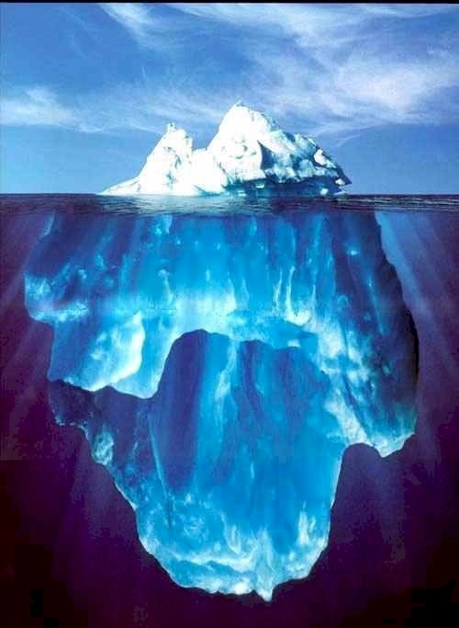
OBSERVABLE
CONSCIOUS THOUGHTS
VABES
Behavior is like an iceberg.

Slide 12
Level | Addresses | What You Get
1 | Visible behavior (1-2%) | BODY
2 | Conscious Thoughts (2-3%) | MIND
3 | Vales, Assumptions, Beliefs, and Expectations (95-97%) | HEART

Slide 13
LEVEL 1 LEADERSHIP TECHNIQUES:
Motivation 2.0
Orders
Commands
Directions
Intimidation
Threats
Coercion
Incentives
Rewards
Manipulation
Goal Setting
      Adopted from Clawson, 2012, Pp. 213-4

Slide 14
LEVEL 2 LEADERSHIP TECHNIQUES:
Motivation 2.5
Logic
Data
Analysis
Reasoning
Charts
Argument
Debate
Discussion
Formulae
Evidence
History
      Adopted from Clawson, 2012, p. 222

Slide 15
LEVEL 3 LEADERSHIP TECHNIQUES:
Motivation 3.0
Self-disclosure
Story telling
Visioning
Honest conversation
Active listening
Protecting confidentiality
Candor
Modeling
Caring
Serving others
Invitations
Respecting others
      Adopted from Clawson, 2012, p. 231

Slide 16
Comparing Leadership Levels
LEVEL 1 LEVEL 2 LEVEL 3
Orders Logic Story Telling
Commands Data Visioning
Directions Analysis Honest Conversation
Intimidation Reasoning Active Listening
Threats Charts Protect Confidentiality
Coercion Argument Self-disclosure

Slide 17
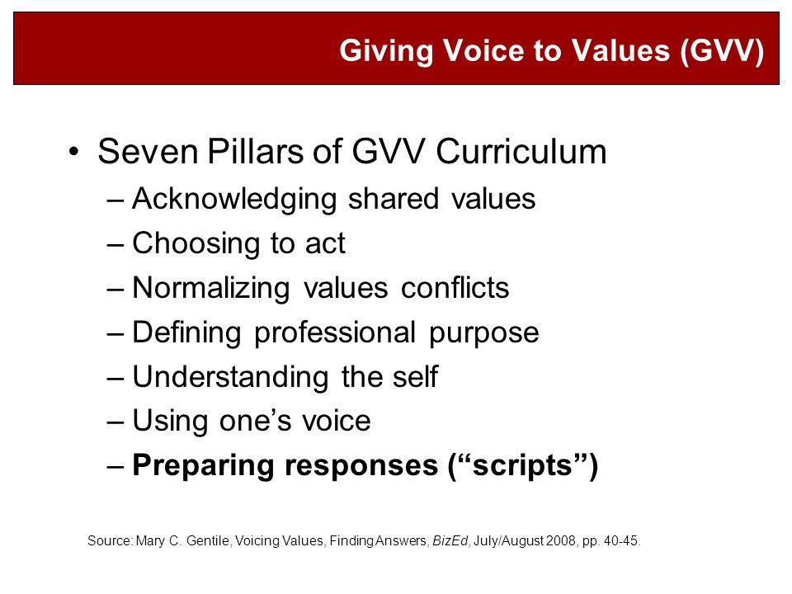

Slide 18
Leadership in Your Life
What leadership level do you see at your job?
What leadership level do you see at IUPUI?
What leadership level do you see in the Kelley School?
What leadership level do you use?

Slide 19
Leadership Principles/Values
Think/Pair/Share
How will you create and sustain “followers”?
What will guide you in your leadership actions and efforts?
How will you sustain your leadership?

Slide 20
Team Reflection
What are your team’s VABES?
What are your basic values and assumptions about the way your team should be working?
What behaviors do you have as a Level One leader?
What thoughts do you have as a Level Two leader?
What VABES do you have as a Level Three leader?

Slide 21
Individual Reflection
What do you do when your personal VABES do not align with your team and/or organizational goals?

